Slide 1
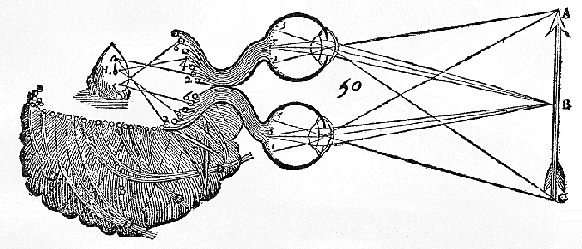
Colourless green ideas sleep furiously

Slide 2
Syntax and Semantics
Syntactical categories:
Language: verb, adjective, pronoun, etc.
Generally: formal categories (e.g. shape, composition, intensity, etc.)
Semantics jargon: meaning, content, reference, intentionality (or “aboutness”)

Slide 3
Representational Theory of Mental Content
Mental representations:
At least as old as Aristotle, reclaimed by Computational Theories of the Mind
Not (necessarily) sensory
Not (necessarily) conscious
What are they?
Possess both a syntactic and semantic nature

Slide 4
Content of Mental Representations
In the Computational Theory of Mind they are the “symbols” which drive causal processes in the brain.
Mid-level of abstraction
Presumably around Marr’s Algorithmic level
“The machine is so devised that it will transform one symbol into another if and only if the propositions expressed by the symbols that are so transformed stand in certain semantic relations – e.g. the relation that the premises bear to the conclusion in a valid argument. Such machines – computers, of course – just are environments in which the syntax of a symbol determines its causal role in a way that respects its content.” (Fodor, Psychosemantics)

Slide 5
Objections
Regress?
Committed to (strong) nativism
Syntax underdetermines semantics
Why explicit representations and not “tacit”:
“It may well be that this linguistic level will appear as an innocently emergent property of the distributed activities of other units rather the way a picture is discernible in a mosaic composed of elements held together by principles that ignore the boundaries of the picture elements.” (Dennett, The Intentional Stance)

Slide 6
Externalism
Is content in the mind?
Intentionality and content as determined by external reference and truth-conditions
Thought experiments:
Twin earth thought experiment (Putnam)
Judy and Trudy (Stampe)
Arthritis thought experiment (social externalism) (Burge)

Slide 7
Objections
Cummins: thought experiments are not conclusive
Loar & Patterson: distinction between linguistic and psychological content
Fodor: “wide” and “narrow” content

Slide 8
Meanwhile in the field of consciousness
https://www.youtube.com/watch?v=MiEVkDdmIF8

Slide 9
It can only be the thought of verdure to come, which prompts us in the autumn
to buy these dormant white lumps of vegetable matter covered by a brown
papery skin, and lovingly to plant them and care for them. It is a marvel
to me that under this cover they are labouring unseen at such a rate
within to give us the sudden awesome beauty of spring flowering bulbs.
While winter reigns the earth reposes but these colourless green ideas
sleep furiously.
C. M. Street
Behold the pent-up power of the winter tree;
Leafless it stands, in lifeless slumber.
Yet its very resting is revival and renewal:
Inside the dark gnarled world of trunk and roots,
Cradled in the chemistry of cell and sap,
Colourless green ideas sleep furiously
In deep and dedicated doormancy,
Concentrating, conserving, constructing:
Knowing, by some ancient quantum law
Of chlorophyll and sun
That come the sudden surge of spring,
Dreams become reality, and ideas action.
Bryan O. Wright

Slide 10
Bibliography
1985 Stanford literary competition: http://www.linguistlist.org/issues/2/2-457.html#2
http://plato.stanford.edu/entries/*:
functionalism/
meaning/
mental-representation/
computational-mind/

